Slide 1
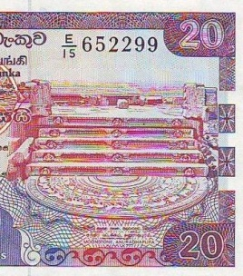
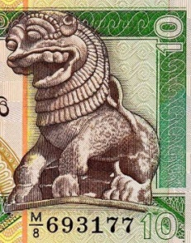
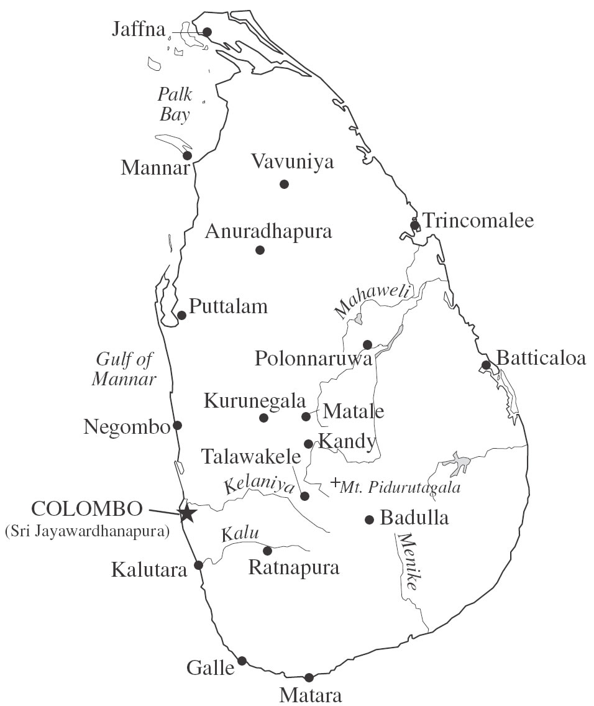
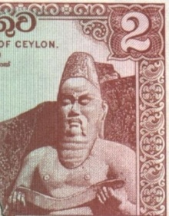
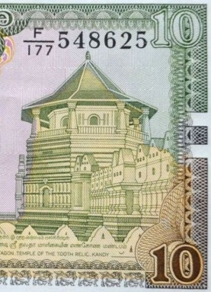
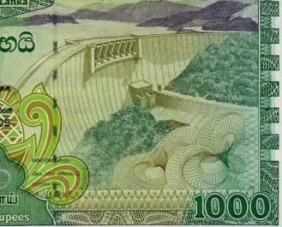
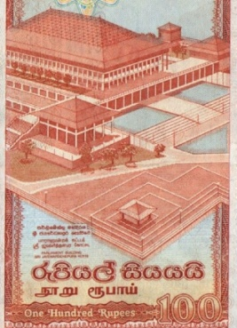
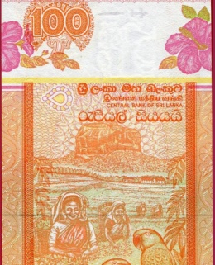
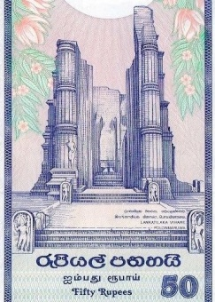
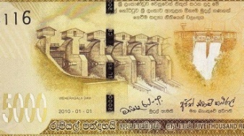
The BANKNOTES of the Socialist Republic of SRI LANKA

Slide 2
In 1972 Ceylon became the Free, Sovereign and Independent Republic of Sri Lanka or Sri Lanka
The Central Bank of Ceylon did not become
the Central Bank of Sri Lanka until 1985.

Slide 3
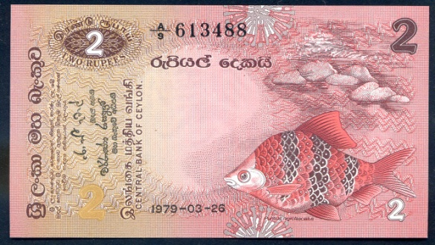
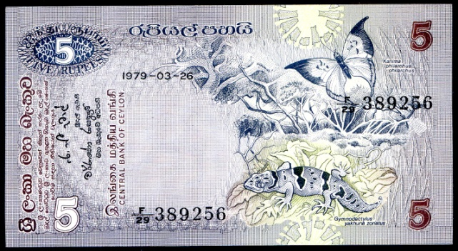
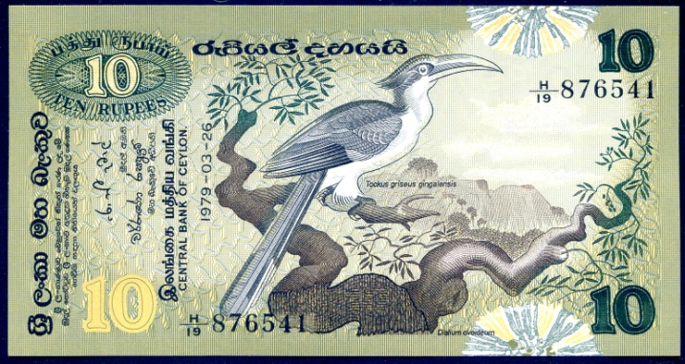
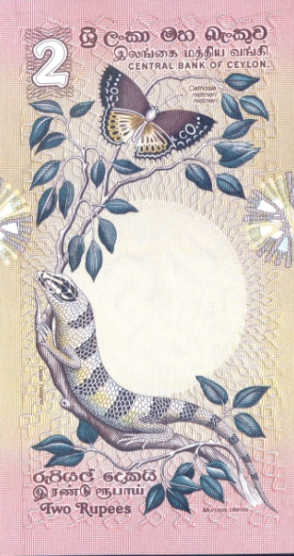
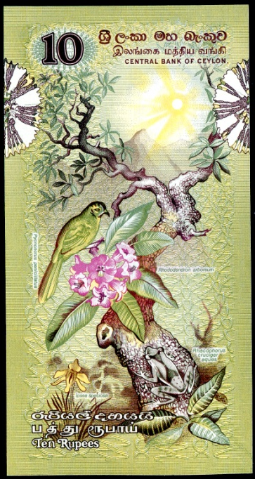
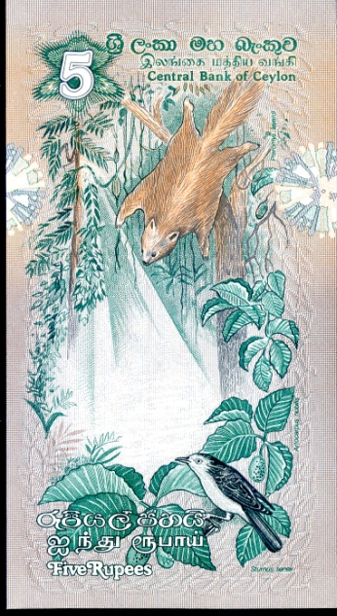
Central Bank of Ceylon Flora and Fauna Issue of 1979 - 1985
According to Owen Linzmayer, this series should be listed as a Ceylon issue.
P-84/B338
5 rupees
P-83a
B337
2 rupees
P-85
B339
10 rupees
The SCWPM, however, lists this series as the beginning of the Sri Lanka issues.

Slide 4
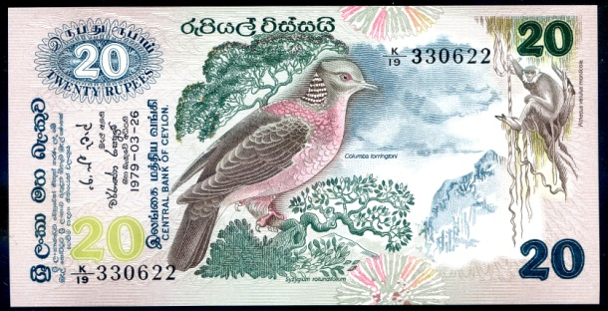
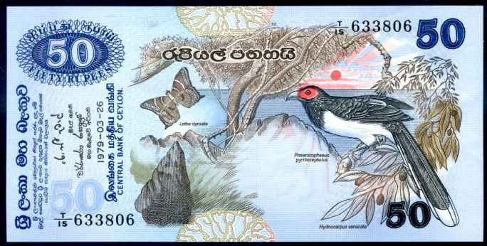
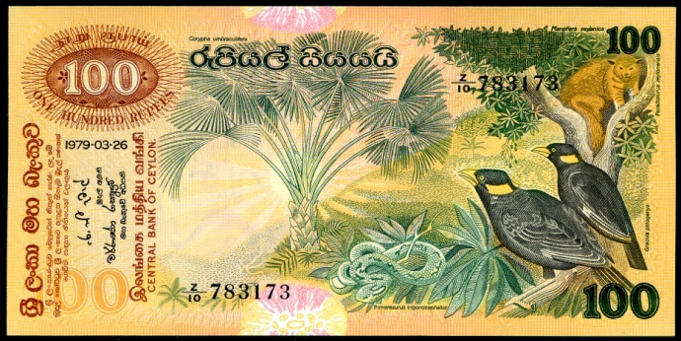
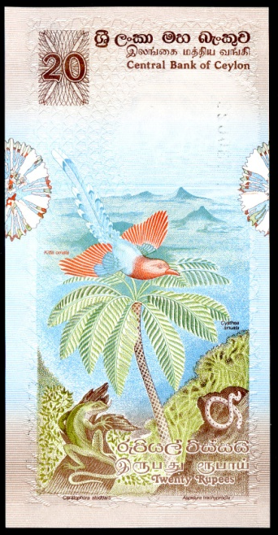
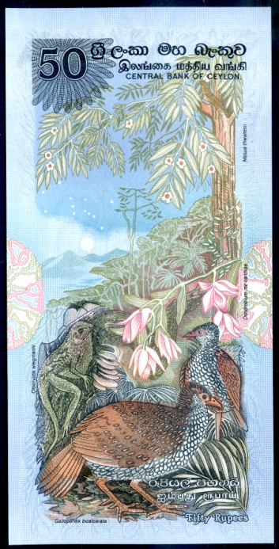
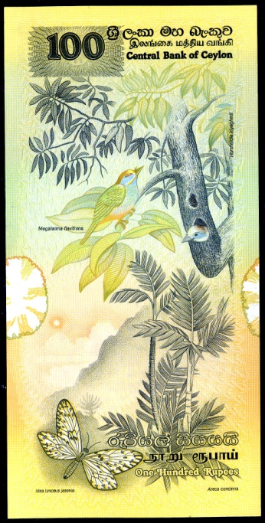
Flora and Fauna issue of the Bank of Ceylon
P-86a/B340 20 rupees
P-87a/341 50 rupees
P-88a/B342 100 rupees

Slide 5
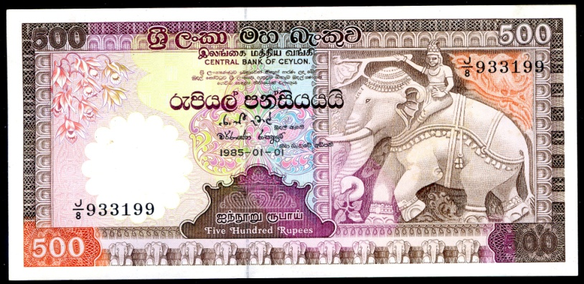
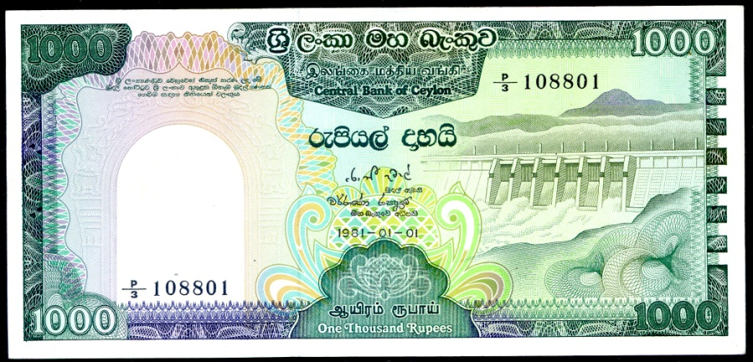
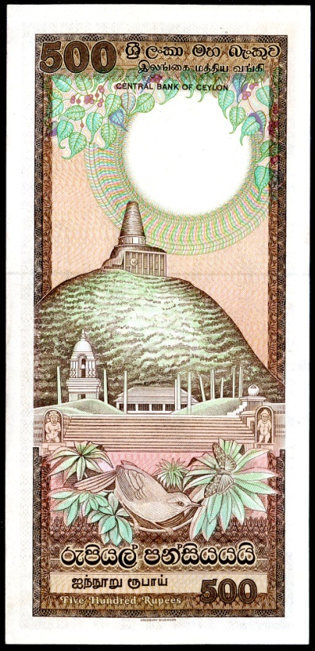
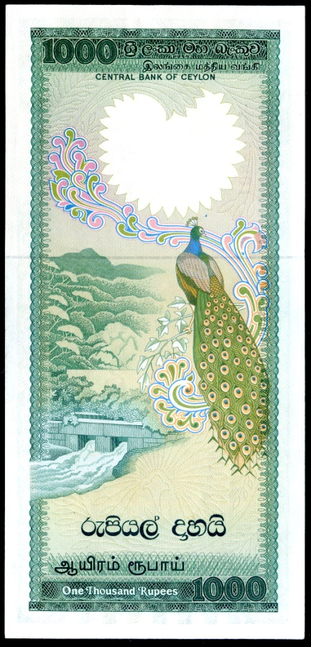
Historical issue of the Bank of Ceylon Central Bank of Ceyon
P-89a/B348
500 rupees
Stone relief of
elephant from
Temple of the
Sacred Tooth, Kandy
--
Anuradhapura Temple
P-90a/B349
1000 rupees
Upper Kothmale
Dam
--
Peacock

Slide 6
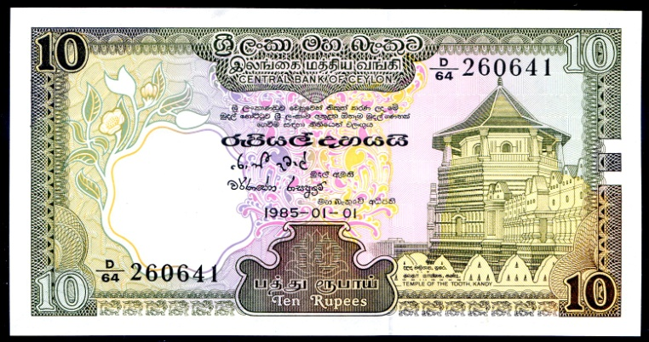
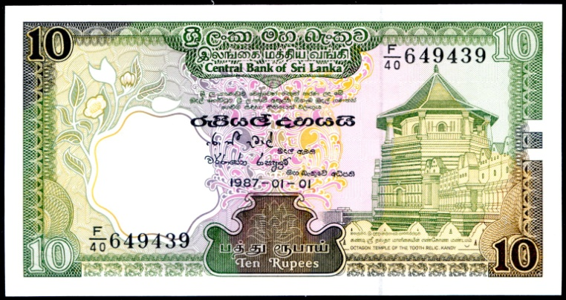
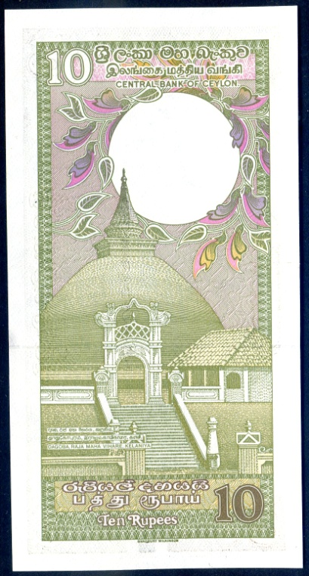
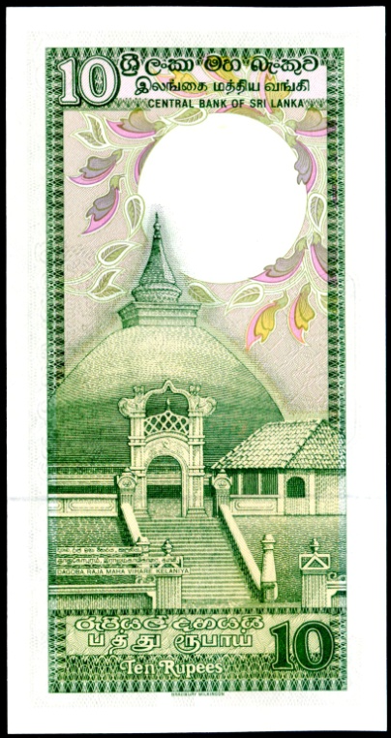
From Ceylon to Sri Lanka
Archaeological and Historical Issues
1982 - 1985
1987 -1990
Central Bank of Ceylon
Central Bank of Sri Lanka
P-92b
B344b
Above: Temple of
the Sacred Tooth
Relic in Kandy.
P-96a
B101a
Dagoba Raja
Maha Vihare Temple
in Kelaniya.

Slide 7
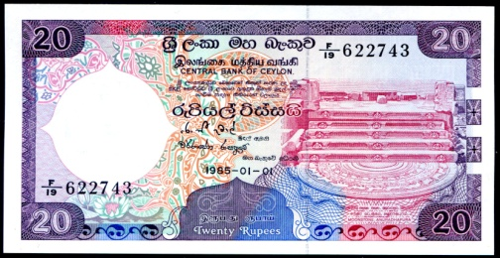
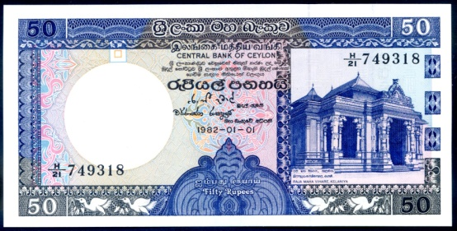
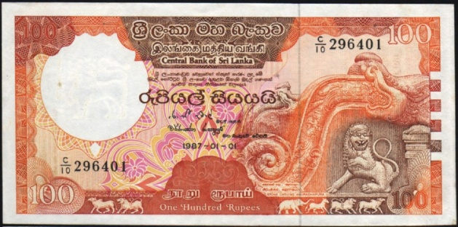
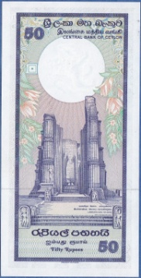
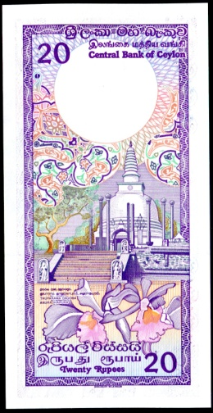
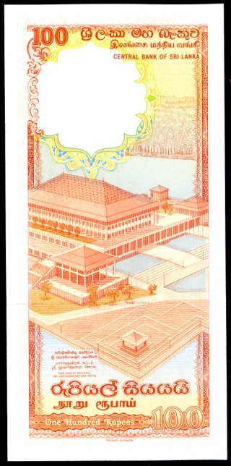
Archaeological and Historical Issue
Central Bank of Ceylon and Central Bank of Sri Lanka
1982 – 1985 1987 – 1990
P-93 & 97
B345 & B102
20 rupees
Moonstone
Steps
--
Thuparama
Dagoba
Temple
P-94 & 98
B346 &B103
50 rupees
Raja Maha
Temple
--
Headless
Buddha
P-95 & 99
B347 & B104
100 rupees
Stone relief
of Chinthe.
--
Parliament
Building
To conserve space, only one example of each of the two Pick numbers
are illustrated. The lower catalog number for each banknote refers to
the Bank of Ceylon. The higher number refers to the Bank of Sri Lanka.

Slide 8
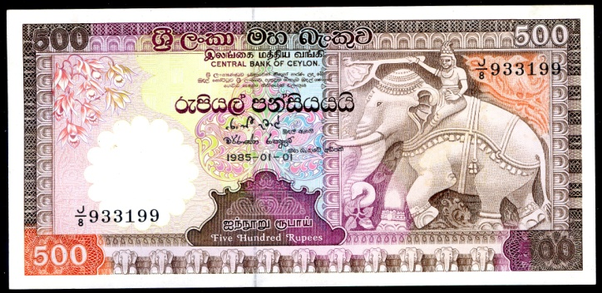
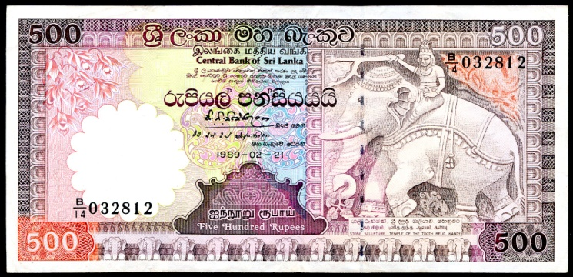
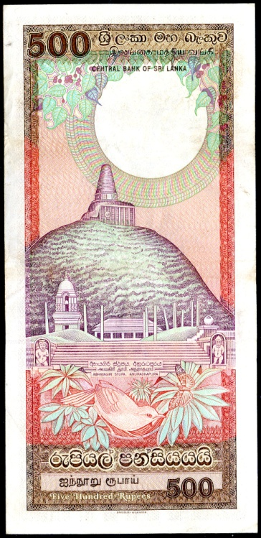
From Ceylon to Sri Lanka
Archaeological and Historical Issues
1981 - 1985
1987 - 1990
P-89/B348
Bank of Ceylon
P-100c/B105c
Bank of Sri Lanka
Back is
predominately
brown and green.
Back is
predominately
brown and red.
500 rupees

Slide 9
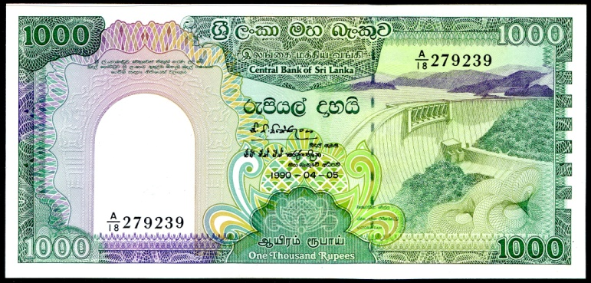
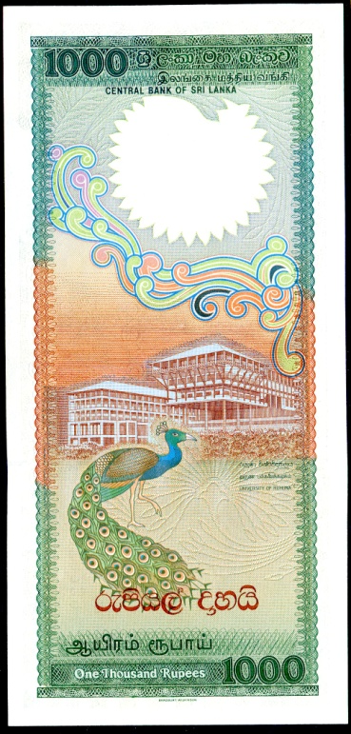
Ceylon becomes Sri Lanka Archaeological and Historical Issues
1981 only
1987 – 1990
P-90/B349
Bank of Ceylon
P101/B106c
Bank of Sri Lanka
Bowattena Dam
--
Spillway and
Peacock
Victoria Dam
--
University of
Ruhuna
1000 rupees

Slide 10
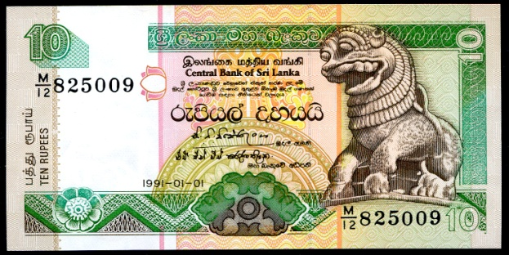
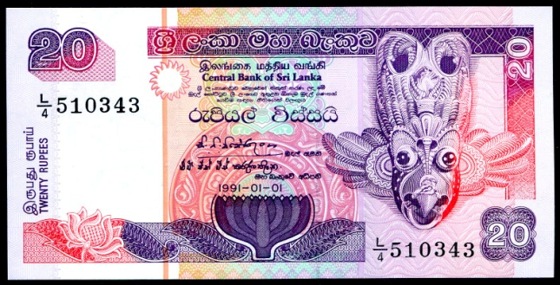
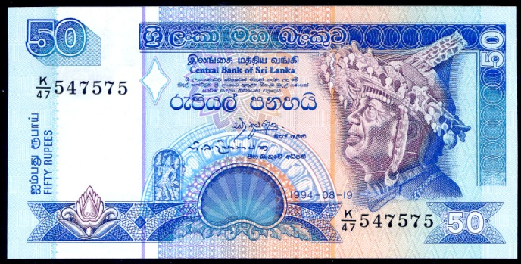
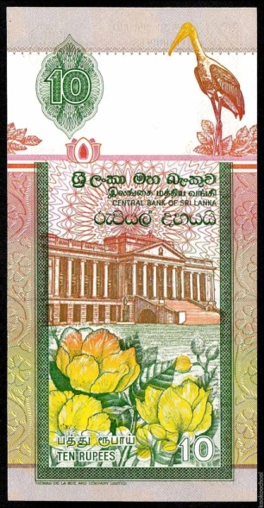
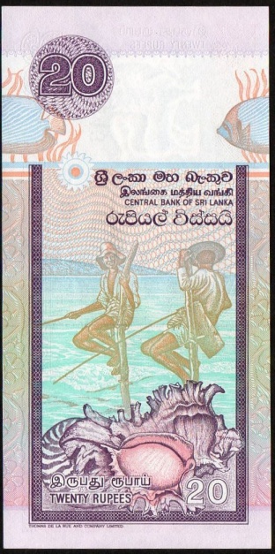
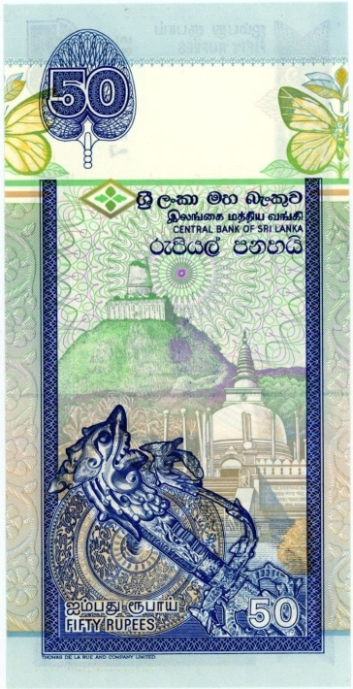
Bank of Sri Lanka
1991 – 1994 Cultural Issue
P-102a/B107a 10 rupees
P-103a/B108a 20 rupees
P-104c/B109c 50 rupees
Sinhalese Chinze
--
Presidential Secretariat
Offices
Devil Mask
--
Sri Lankan Pole Fishermen
Male Dancer in Headdress
--
Jetavana and Tuparama Stupas

Slide 11
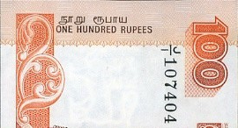
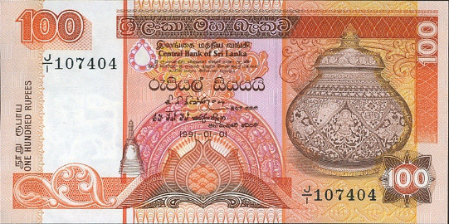
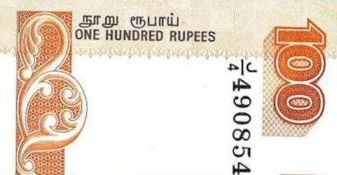
Bank of Sri Lanka 1991 – 1994 Cultural Issue 100 rupees, ornate urn
P-105a/B110a
Without dot.
P-105b/B110b
With dot
Origin of the dot is somewhat
mysterious. Lowest serial number
found has a dot.

Slide 12
Bank of Sri Lanka 1991 – 1994 Cultural Issue 100 rupees – Ornate Urn Types
P-105A
B111
Orange back.
P-111 & P-118
B117
Latent,
embossed
image on face.
Orange back.
P-105 a & b
B110b
Brown back.

Slide 13
Bank of Sri Lanka 1991 – 1992 Cultural Issue High Values
P-106a/B112a
500 rupees
Kandyan Dancer and
Traditional Drummers
--
Ruwanwelisaya Stupa
in Anuradhapura
P-107b/B113b
1000 rupees
Festive elephant
--
Temple of the Sacred
Tooth at Kandy

Slide 14
Bank of Sri Lanka 1995 – 2006 Cultural Issue
P-108 & 115
B114
Chinthe
sculpture
--
Presidential
Secretariat
Offices
P-109 & 116
B115
Devil Mask
--
Fishermen
P-110 & 117
B116
Kandyan Dancer
--
Stupas in
Anuradhapura
This series is distinguished from the previous cultural issue by a latent, em-
bossed shield added to the centre-face of each denomination. Although
two Pick numbers are given, the Banknote Book has proven the notes are
the same, except for signatures and dates.

Slide 15
Bank of Sri Lanka 1995 – 2006 Cultural Issue
P-111 & 118
B117
Ornate Urn
--
Women
Harvesting Tea
P-112 & 119
B118
Kandyan Dancer
and Drummers
--
Stupa and Lotus
Stem Pillars in
Anuradhapura
P-113 & 120
B119
Sathdantha Elephant
--
Temple of the
Tooth in Kandy

Slide 16
New High Value 2000 rupees, P-121/B120 2005 and 2006
Ruins of Sigiriya (Lion Rock) Castle near Sesatha.
Fresco from Siginya.

Slide 17
Sri Lanka Commemorates 50 Years of Independence 200 rupees, 1998, Polymer, P-114
Red Serial Number P-114a/BNP101
Black Serial Number P-114b/B121a
Bandaranaike Memorial International Conference Hall
with scenes of Progress.
20 million issued.
Commemorative folder
for P-114a/BNP101
Temple of the Sacred Tooth Relic in Kandy
with scenes of Sri Lanka’s national heritage.

Slide 18
Commemorating The Ushering in of Peace and Prosperity to Sri Lanka 1000 rupees, 2009, P-122/B122
Sri Lanka’s first President
Mahinda Rajapaksa
Hoisting of the national flag by Sri Lanka’s military services.
Cover of folders used for 1500
low-serial-numbered banknotes.
All together, 25 million copies of
this note were issued.

Slide 19
On the 60th anniversary of its establishment, the Central Bank of Sri Lanka issued a new series of banknotes. The theme on the faces of the banknotes was “Development and Prosperity, flanked by island butterflies and birds. The backs depicted various traditional dancers from around Sri Lanka.
Serendib
Scops Owl
Dull-Blue
Flycatcher
Baronet
Butterfly
Blue
Oakleaf
Butterfly
Port of Colombo
20 rupees, P-123/B123
Old and new bridges
50 rupees, P-124/
Geta Bera
Drummer
Ves Netuma
Dancer
Yakbera
Drummer
Vadiga Patuna
Dancer

Slide 20
2010 60th Anniversary Issue
Development and Prosperity
Butterflies, Birds and Dancers
Norochcholai Power Plant, 100 rupees, P-125/B125
World Trade Centre 500 rupees, P-126/B126
Layard’s
Emerald –
collared
Parakeet
Autumn
Leaf
Butterfly
Orange-
bill
Babbler
Indigo
royal
Butterfly
Mridangam
drummer
Bharatanatyam
dancer
Yak Bera
drummer
Thelme
Netuma
dancer

Slide 21
2010 – 60th Anniversary Issue
Development and Prosperity
Butterflies, Birds and Dancers
Hanging
Parrot
Yellow-
eared
Bulbul
White
Four-ring
butterfly
Lemon
Migrant
butterfly
Ramboda Tunnel, 1000 rupees, P-127/B127
Weheragala Dam, 5000 rupees, P-128, 2011/B128
Davul Bera
drummer
Malpadaya
Netuma
dancer
Guruluraksha
and
Nagaraksha
dancers

Slide 22
Commonwealth Heads of Government Meeting Colombo, Sri Lanka, 15 – 17 November 2013 500 rupees, P-129/B129
World Trade Centre, Bank of Ceylon, Lankathilaka Viharaya Buddhest Temple
CHOGM 2013 Logo
Each CHOGM delegation member was provided
a copy of the banknote in a souvenir folder, which
was also made available to the public. Note was
circulated, without folder, to the general public –
25 million were printed.

Slide 23
THE END
Acknowledgements:
Ceylon Chapter of the Banknote Book; Owen Linzmeyer
Sri Lanka Chapter of the Banknote Book; Owen Linzmeyer
Standard Catalog of World Paper Money, Vol. III, Ceylon and Sri Lanka
Wikipedia: Various articles
Central Bank of Sri Lanka
Google Images

